Slide 1


www.iamfootballcoach.in
I’m football
Coach
Automatically data analysis

Slide 2

All clubs and federations work with video
In the amateur level, matches can be recording
From the video we can generate all neededa data

Slide 3


Data menagement
solution
We integrate different data sources into one platform
Based on artificial intelligence, we analyse video of the games and generate data
From the video we can extract all needed data
Based on the all available data, we generate the game model of the team
We are looking for trends, patterns, etc.
The system works on professional, amateur and youth levels

Slide 4
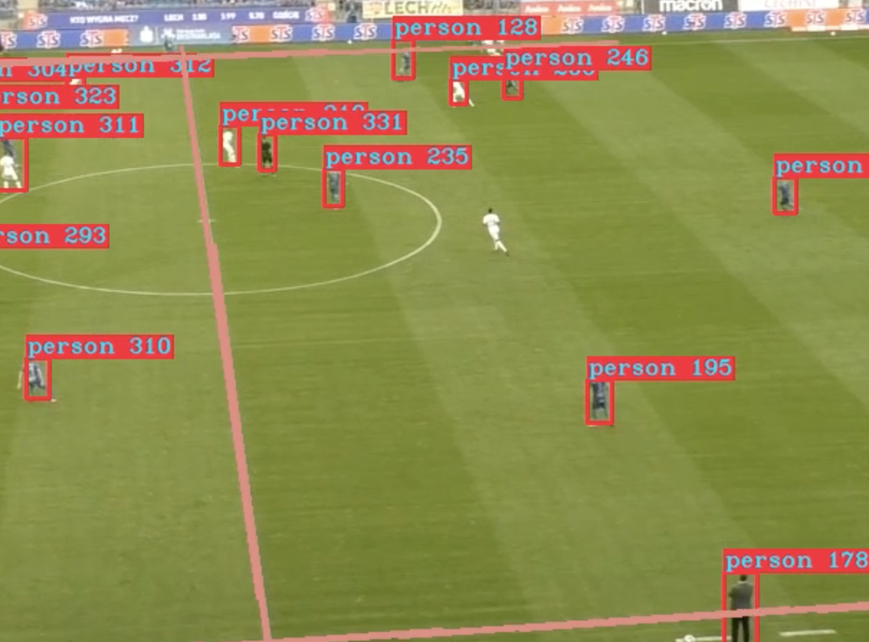
How It works
Upload match/training video
Data will be generated based on the video
Algorithms will analyze all the material
The trainer will receive the corresponding video with the selected analysis and On-pitch event data files, positional data (xyz coordinates of players and ball)

Slide 5
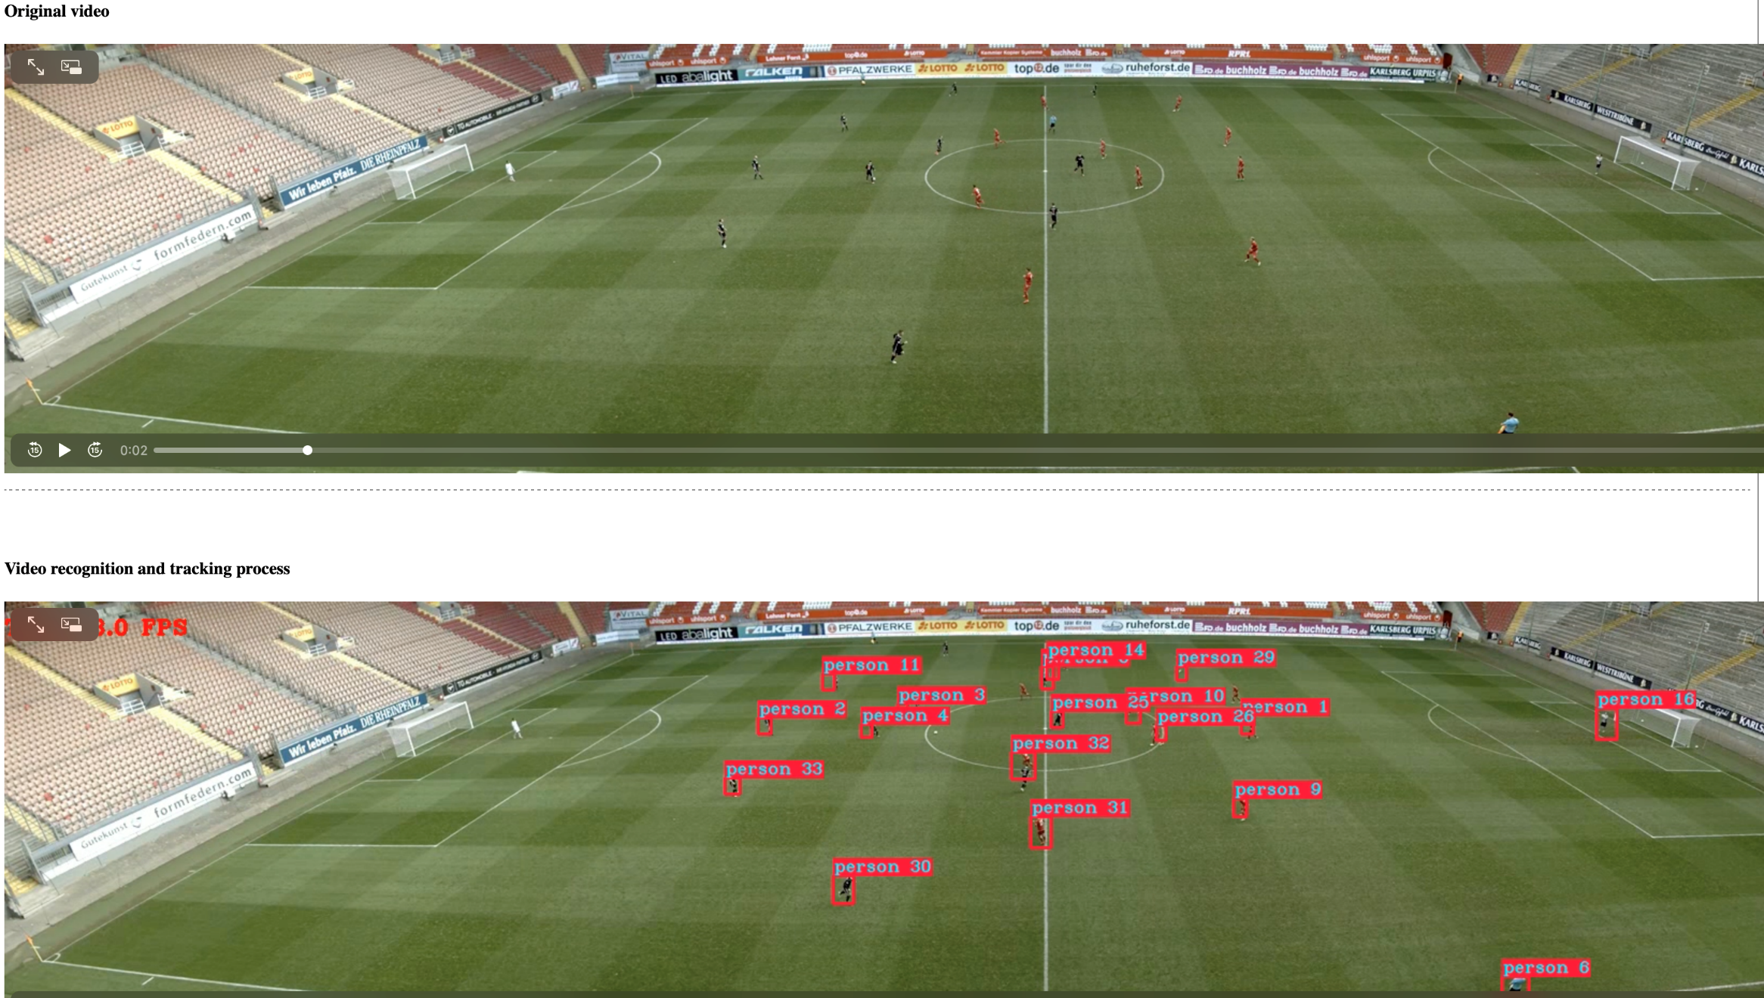
How It works

Slide 6
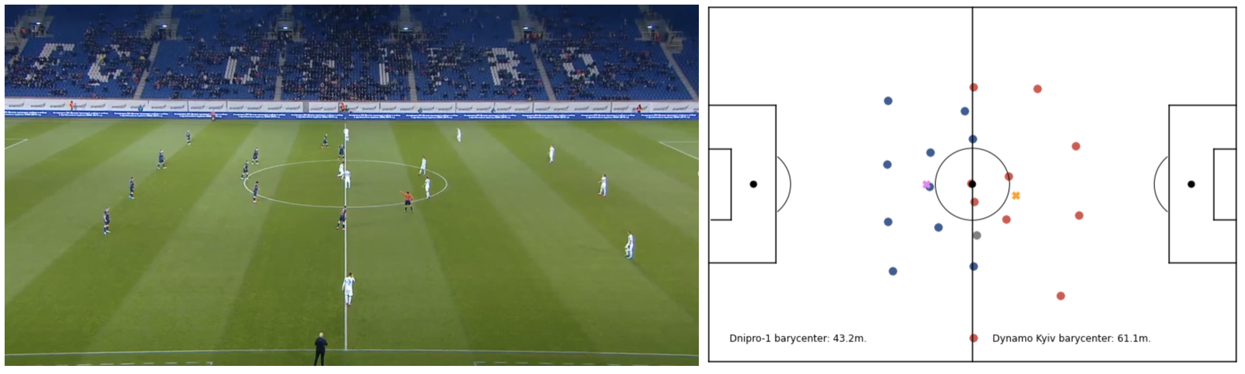
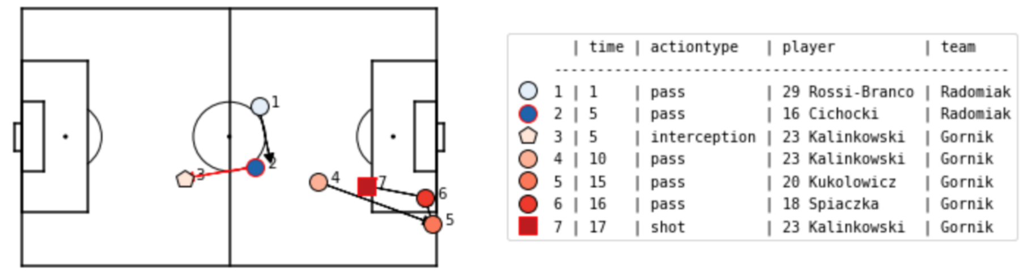
How It works

Slide 7
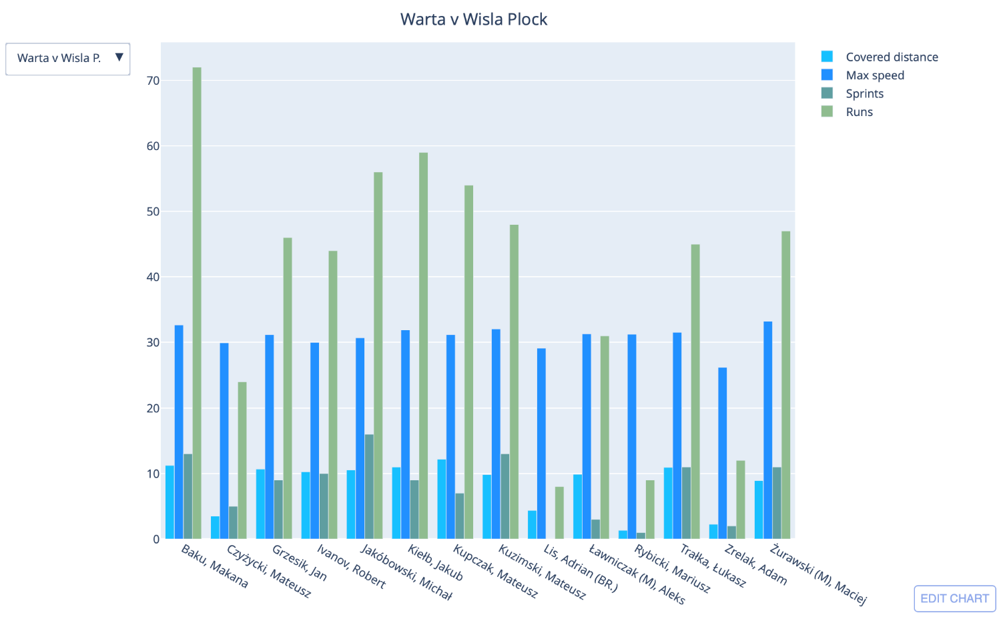
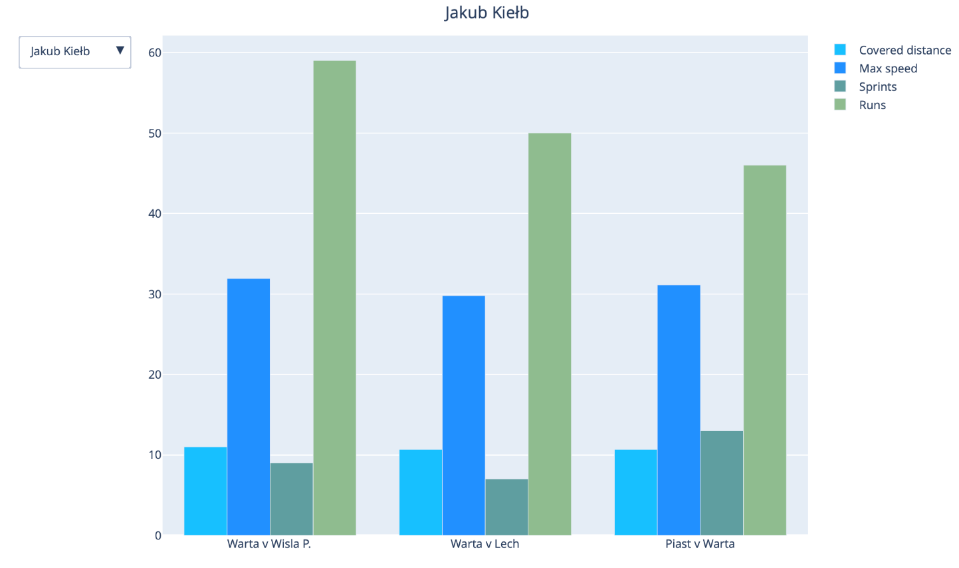
How It works

Slide 8
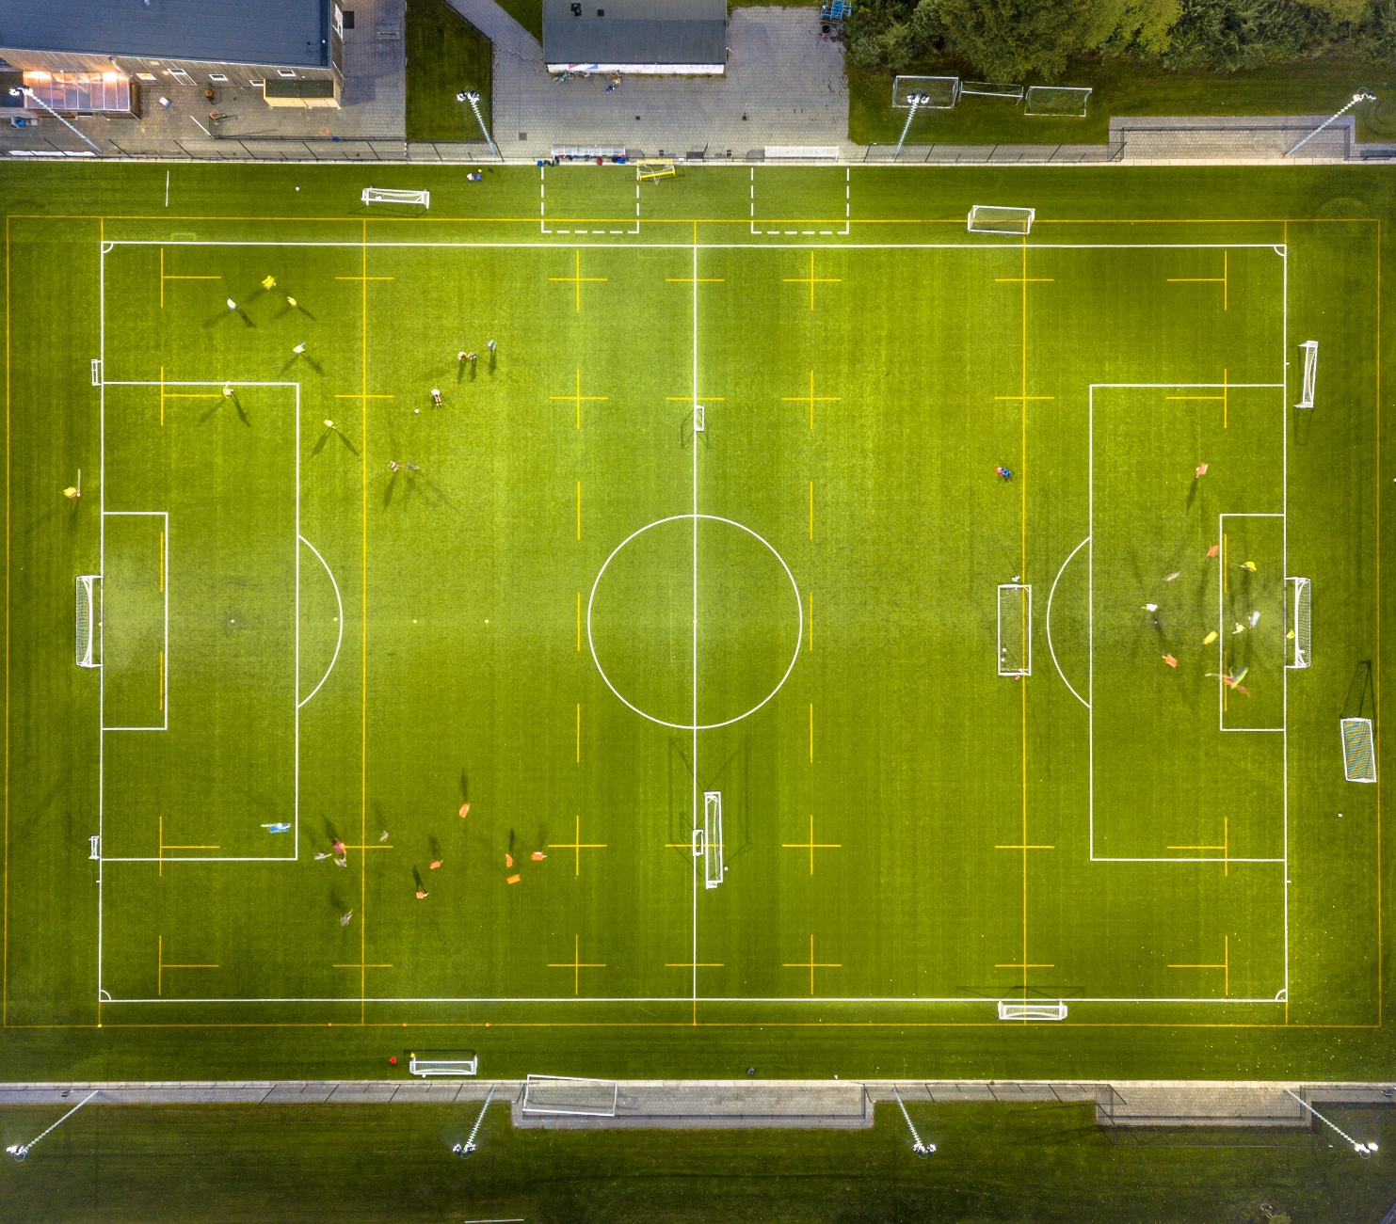
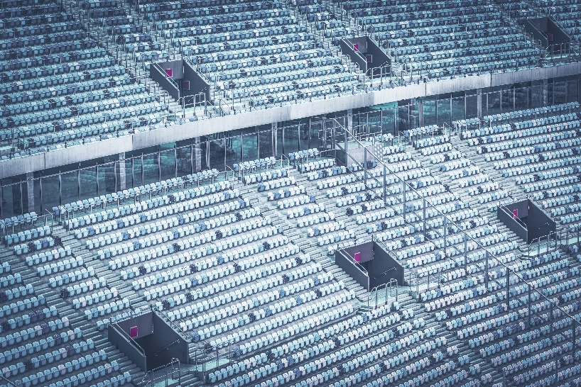
Contact COMPANY
PROFILE
description about company
Adress Mumbai
Phone +91 81691 00364, +421 9173 11108
Mail info@iamfootballcoach.in
https://www.iamfootballcoach.in

